Slide 1
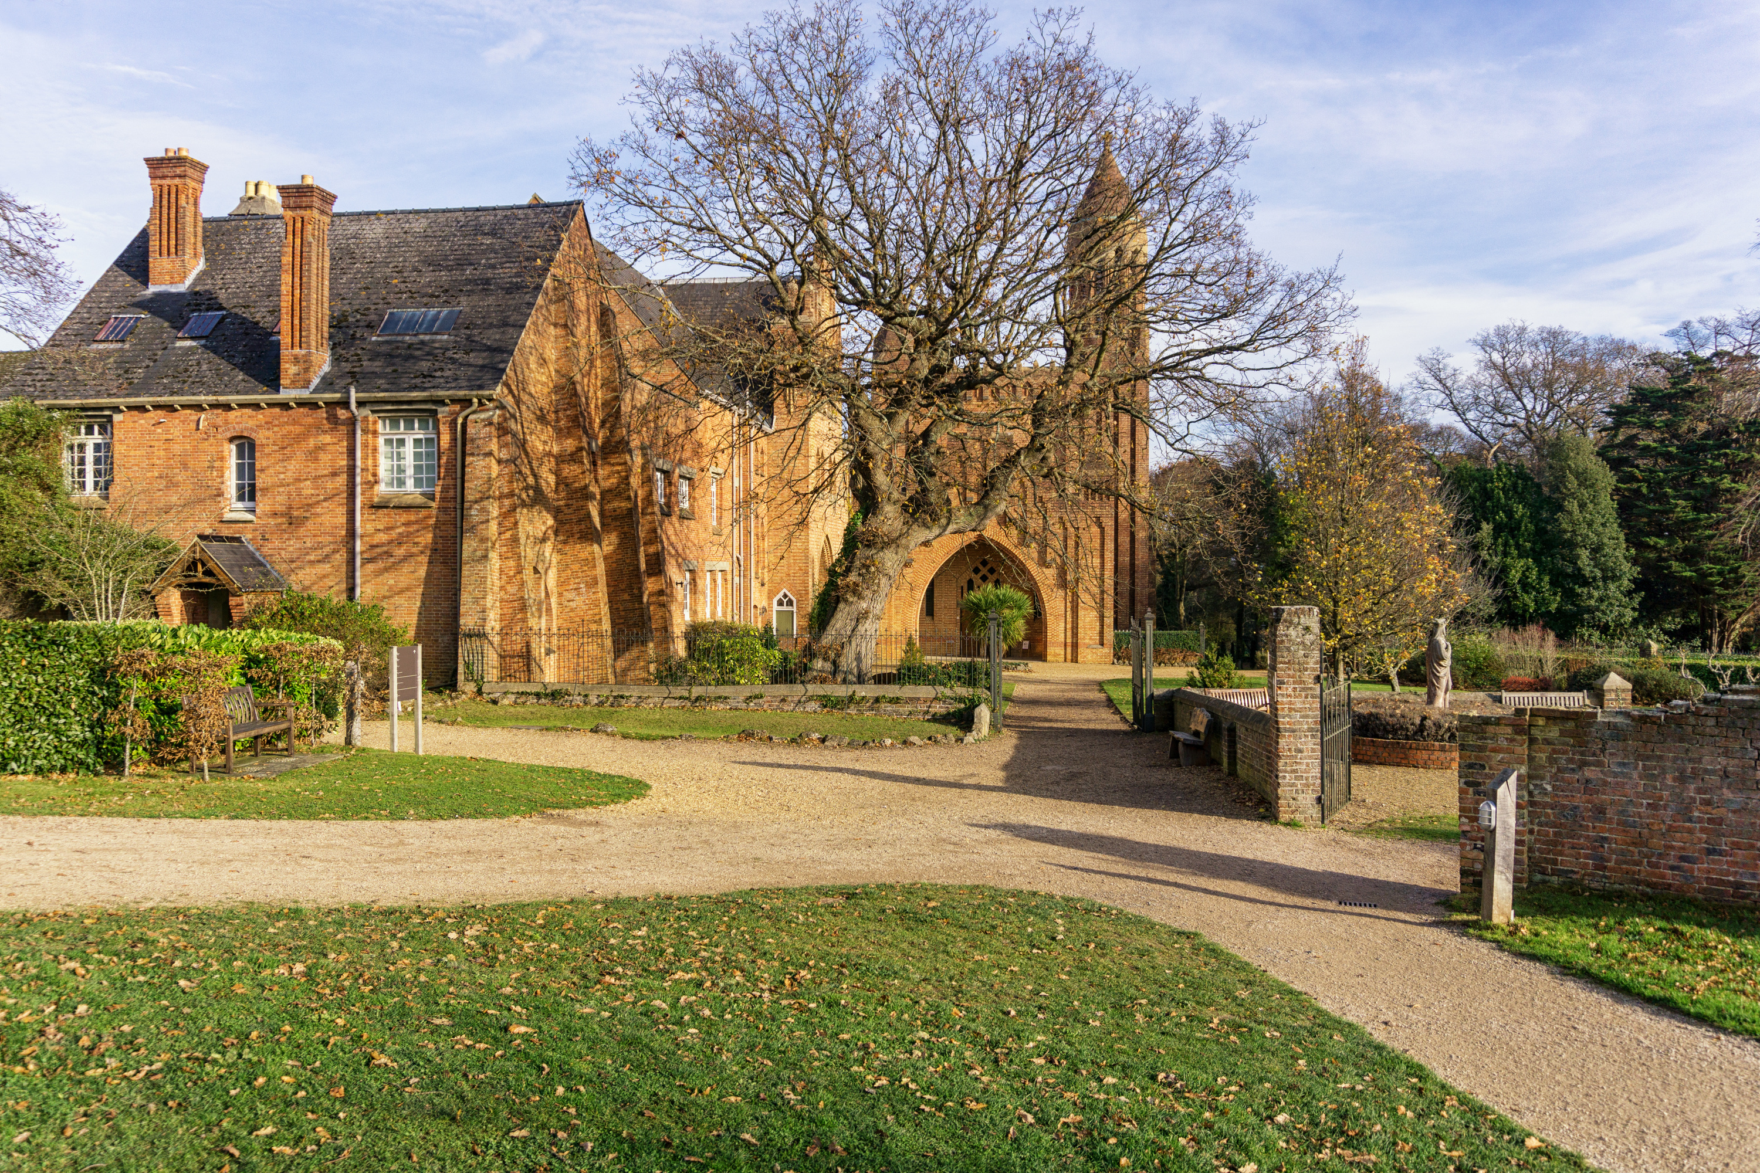

WORLD DAY OF
CONSECRATED LIFE
2 FEBRUARY

Slide 2
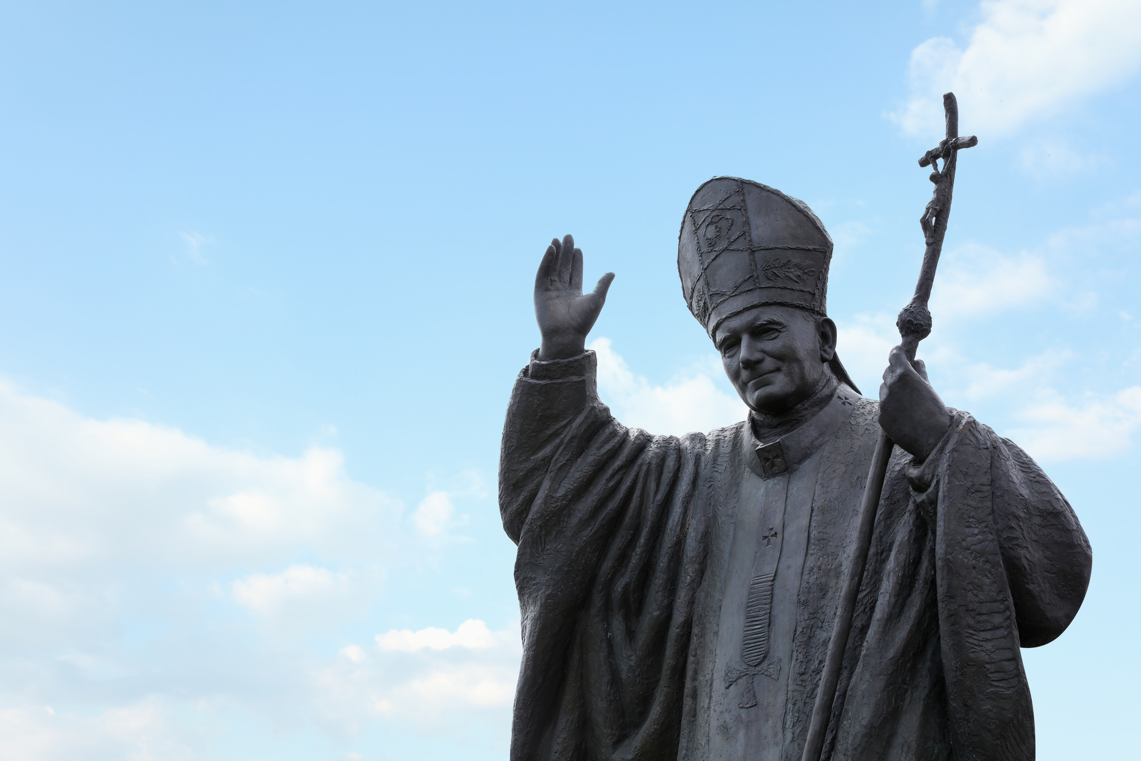
WHAT DOES IT MEAN TO BE CONSECRATED?
The word “consecration" is used in the Catholic Church as the setting apart for the service of God of both persons and objects.
In 1997 St John Paul II instituted a ‘World Day of Prayer for Consecrated Life’

Slide 3
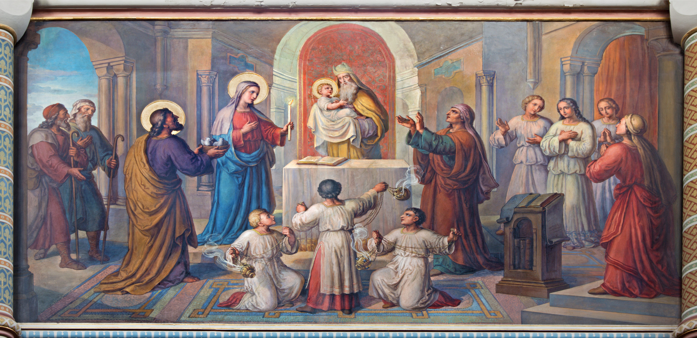
GOSPEL
“My eyes have seen your salvation that you have prepared in the presence of all peoples, a light for revelation to the Gentiles, and for glory to your people Israel.”

Slide 4
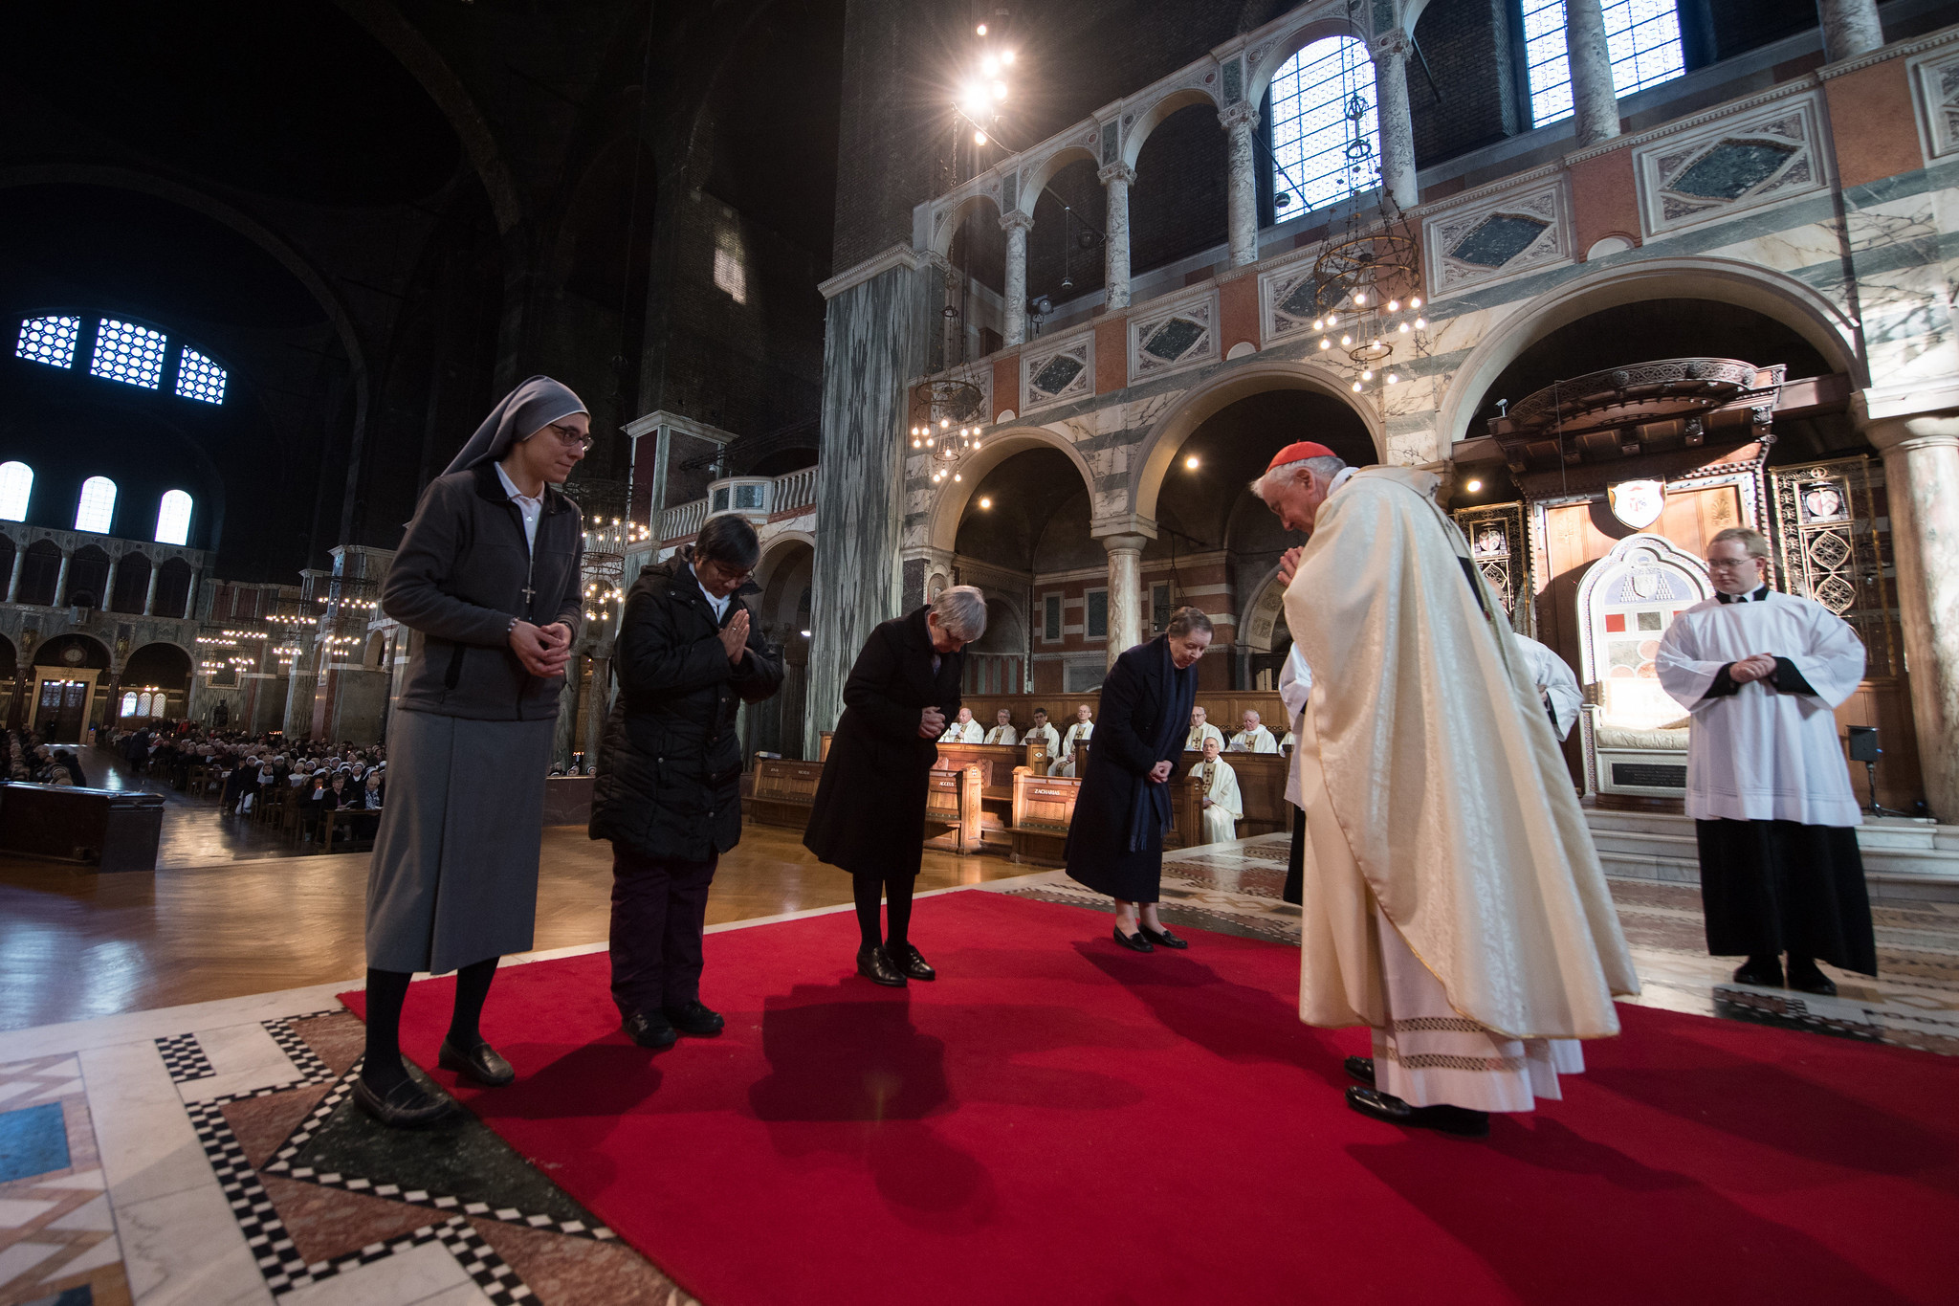
REFLECTION
“The consecrated life takes many and varied
forms but at the root of all of them is the handing over of oneself to Jesus
Christ in his poverty, obedience and chastity”.
Bishop Alan Williams SM
Bishop of Brentwood

Slide 5
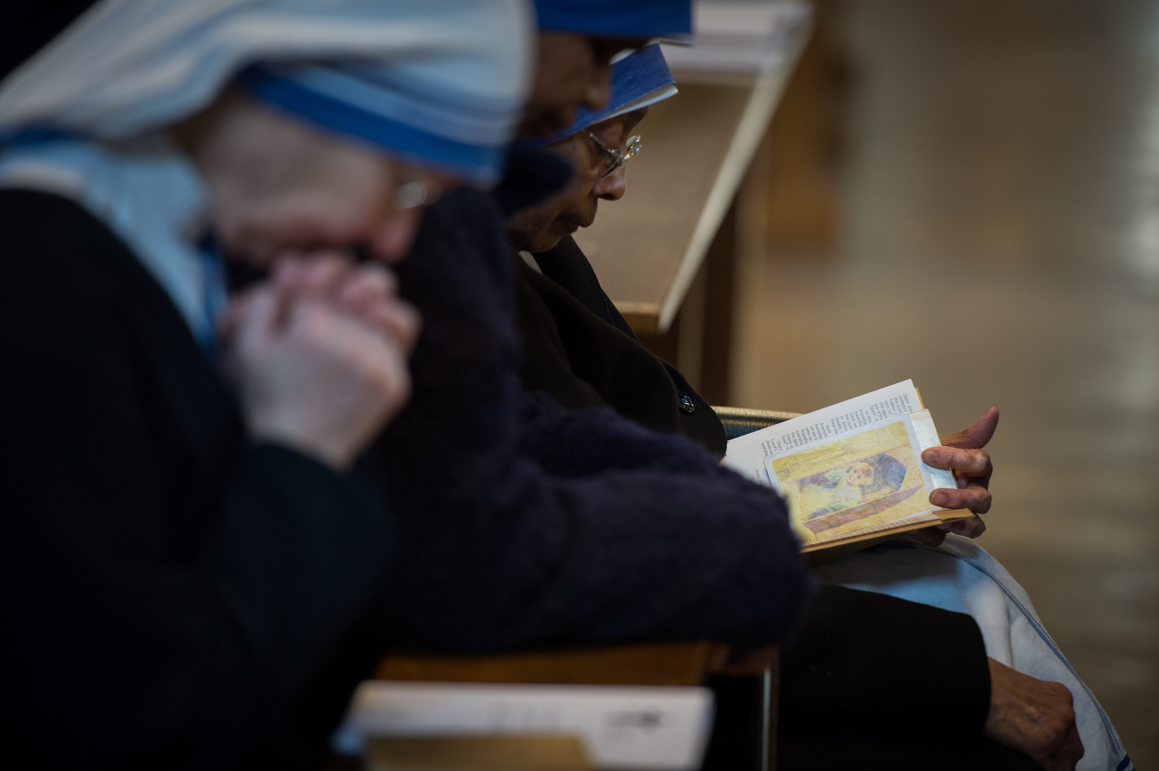
PRAYER
God our Loving Father, we thank you for the life and testimony of men
and women whom you have called to serve you as sisters, brothers,
religious priests and other consecrated people. Help them to be more and more rooted in you by following
the evangelical counsels. We pray for those of them discerning their
vocation, grant them the strength to respond to your call courageously.
We make this prayer through Christ our Lord.
Amen

Slide 6
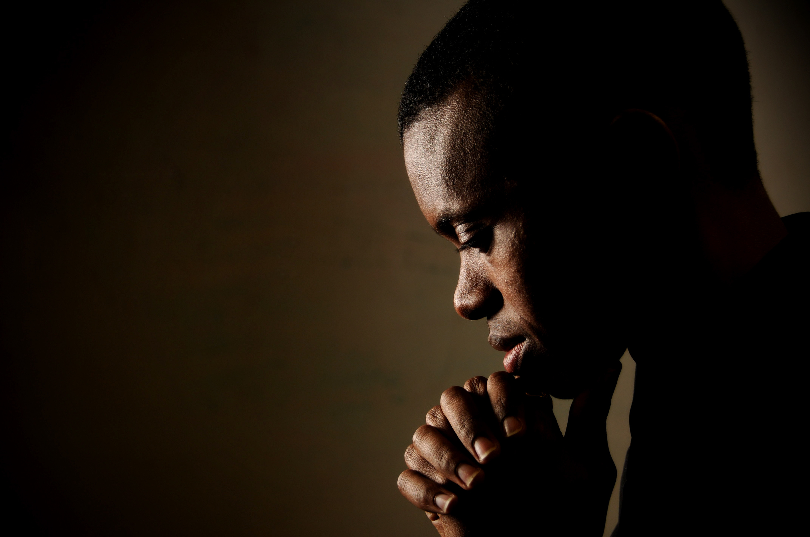
OUR FATHER
Our Father, who art in heaven, hallowed be Thy name. Thy Kingdom
come. Thy will be done, on earth as it is in Heaven. Give us this day our
daily bread. And forgive us our trespasses, as we forgive those who
trespass against us. And lead
us not into temptation,
but deliver us from
evil.
Amen.

